Slide 1
Introduction to prototyping

Slide 2
What is prototyping and its purpose?
When can I use it in my design process?
How can I use it in my work?
What are the different prototyping techniques?
Notes:
We will answer the following questions in this presentation.

Slide 3
What is prototyping?
an experimental model of an idea
it is a way to give our idea a presence that we can place in front of somebody to see if our idea has value
Notes:
A simulation of the interaction between the user and the interface.

Slide 4
Success
Building without prototyping

Slide 5
Success
Building with prototyping

Slide 6
Ideas
Learn
Prototyping
Build
Data
Code
Measure

Slide 7
What’s the purpose of a prototype?
communication: ideas can be frightening, and the basic concept difficult to grasp
feedback and ideation: talking about an abstract idea can be difficult
agreement: long emails and documents are continuously iterative because the concept is not concrete – how many times have you deliberated business requirements?
Notes:
This slide is put in on purpose. We can put this in the context of business requirements vs business outcomes.

Slide 8
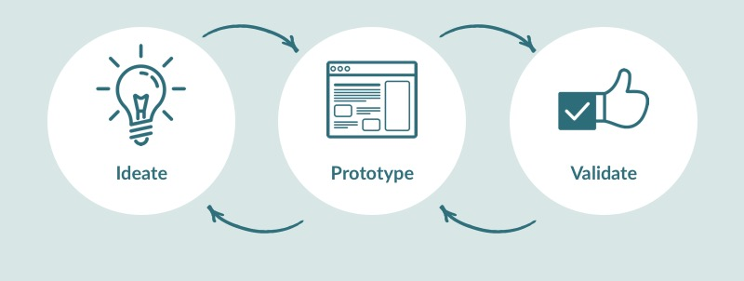
When can I use it in my design process?

Slide 9
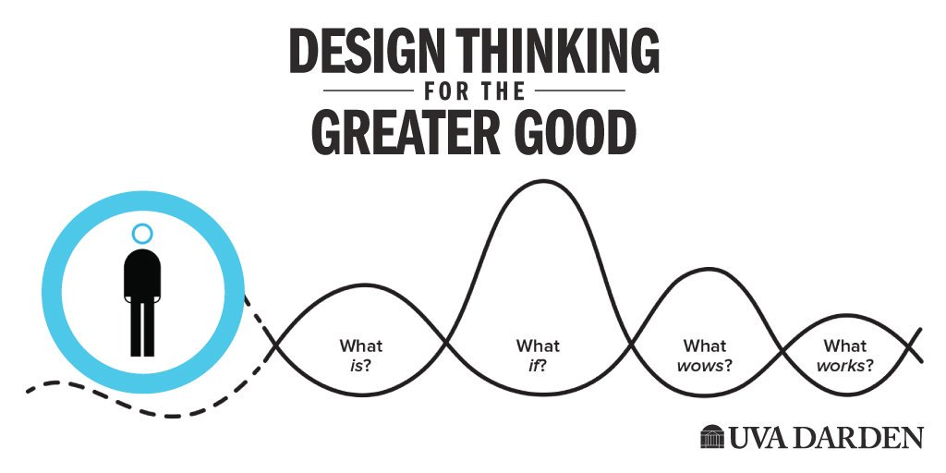
When do you need a prototype?
what if….?
how would it look if…?
if is a good place to start: our imaginative senses have different inspirations and so create different mental images, once you start ideating it’s time to prototype
Notes:
It is the What if in the design thinking process.

Slide 10
Types of prototypes and their usage
A film (movie) prototype: Here a prototype is made using video just to show others the idea in a graphical/visual format.
Feasibility prototype (PoC): This type of prototype is usually developed to determine the feasibility of various solutions. It is applied to the resolve technical risks attached to the development in terms of performance, compatibility of components etc.
Horizontal prototype: This is the user interface in the form of screenshots, demonstrating the outer layer of the human interface only, such as windows, menus, and screens. The prototype is used to clarify the scope and requirements of the product.
Notes:
https://www.entrepreneur.com/article/308724

Slide 11
Types of Prototypes and their usage
Rapid prototype (physical products): The rapid prototyping technique is used to quickly engineer an initial model of a product using a three-dimensional computer-aided design when you want to produce something in a short span.
Simulations (PoC): Simulation prototype is digitally creating of a physical product to predict the performance of the product in the real world.
Storyboard: A storyboard describes a product in a form of a story and demonstrates a typical order in which information needs to be presented. It helps in determining useable sequences for presenting information.

Slide 12
Types of Prototypes and their usage
Vertical prototype: A vertical prototype is the back end of a product like a database generation to test front end. It used to improve database design, test key components at early stages or showcase a working model, though unfinished, to check the key functions.
Wireframe: This is a skeleton a product. Depicted in the form of illustrations or schematics that capture an aspect of design such as an idea, layout, form, architecture or sequence.
Animations: These are images drawn and put in a sequence that walks you through the proposed 3D structure of the product/solution.
Mock-up: This is with no functionalities, just to get overall visual of the product. It is an unpolished version of the product with no active features.

Slide 13
Horizontal Prototyping
Sketching

Slide 14
What is fidelity
design fidelity:
level of detail and functionality included in a prototype.
fidelity can vary in interactivity, visuals, content and commands, and other areas.
varies in level according to the stage of the process

Slide 15
low fidelity (lo-fi) paper sketches: sketching – at scale or freehand / paper cutting / scrapbooking / cartooning
lo-fi, monochromatic wireframes: computer generated / minimum level of details
high-fidelity (hi-fi), clickable mockups: computer generated / with application user interactions
fidelity of your prototype should match the fidelity of your thinking
Notes:
Prototypes can take different forms, it helps to classify them in terms of dimensions.

Slide 16
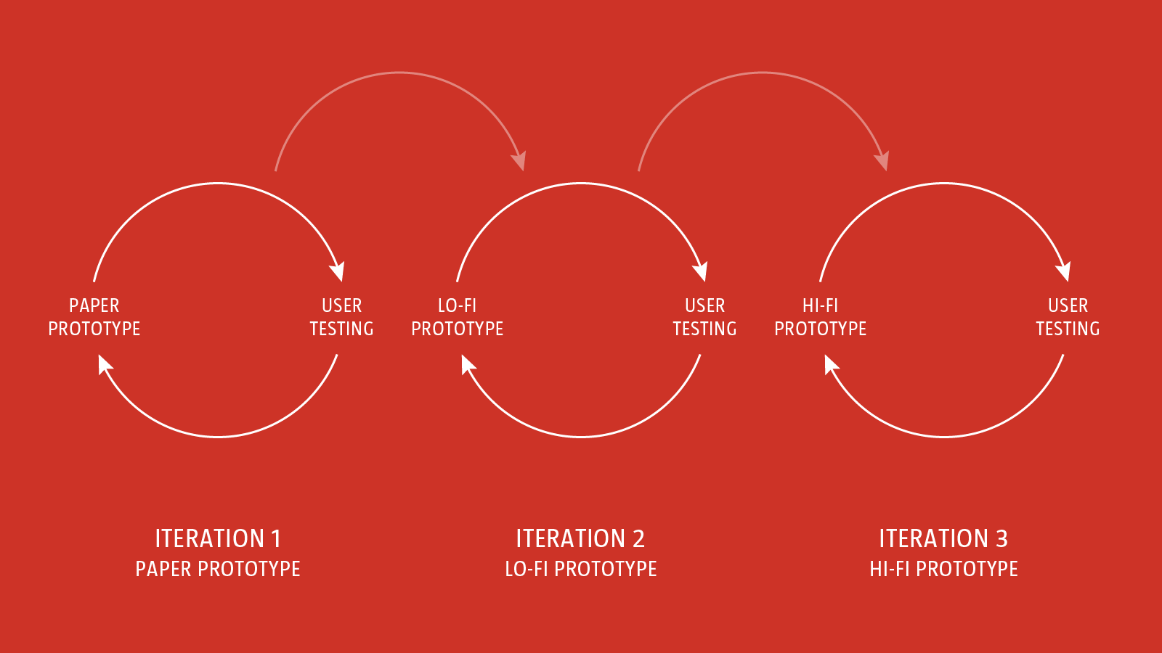

Slide 17
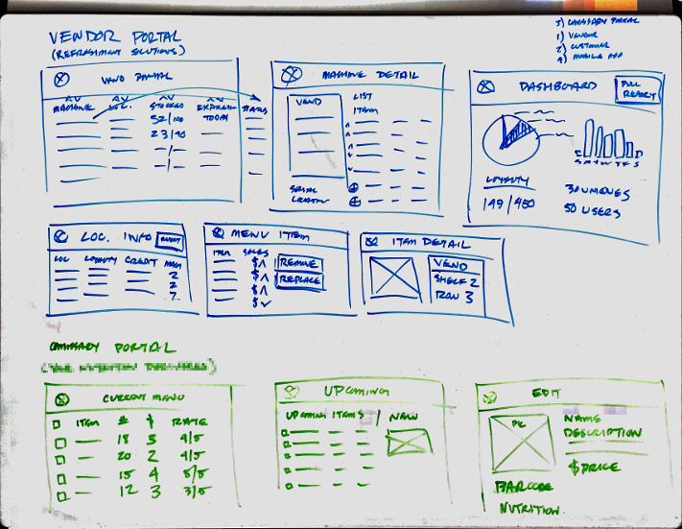
What is paper prototyping
At the start of the journey it’s important to focus on low-fidelity approaches that are low cost and fast to implement. Paper is the perfect prototyping tool at this stage in the process.

Slide 18
Ideas
Learn
Prototyping
Build
Data
Code
Measure

Slide 19
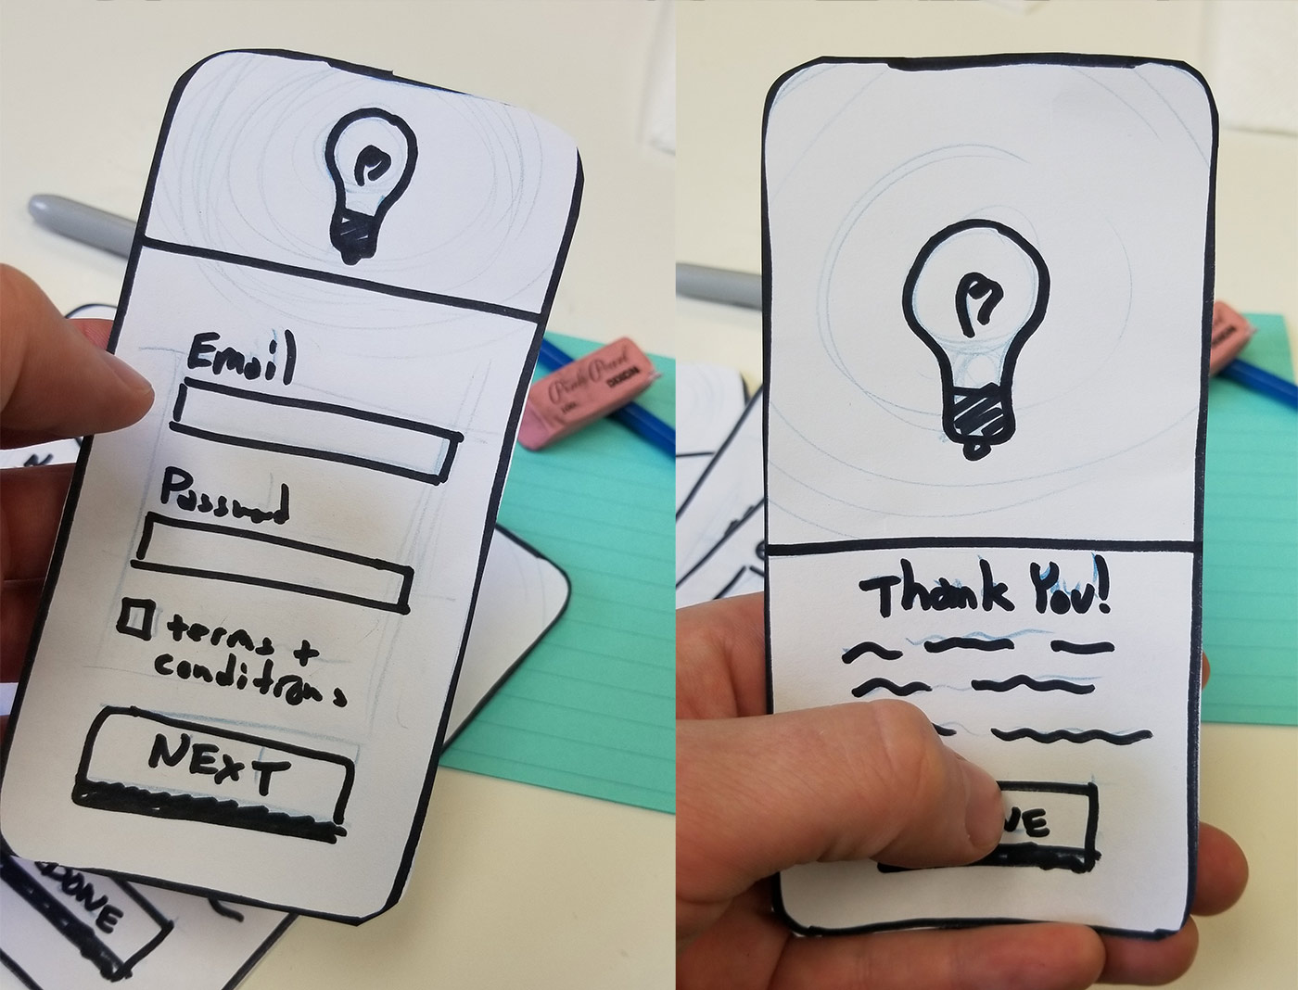
Notes:
A simulation of the interaction between the user and the interface.

Slide 20
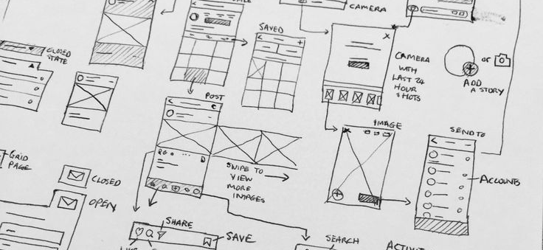
Lo-fi paper prototypes (sketches)

Slide 21
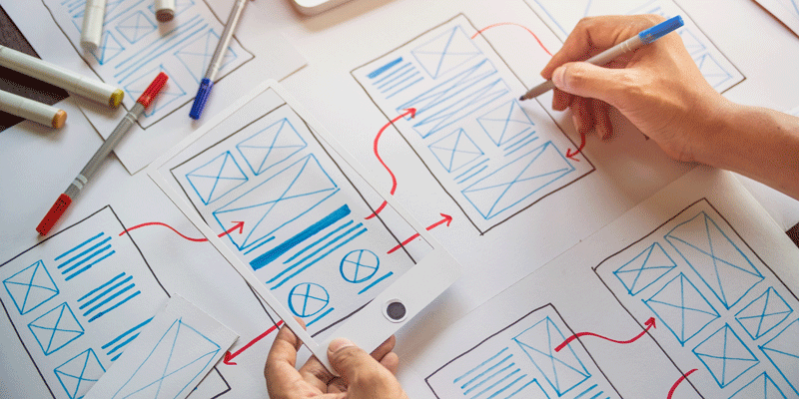
Notes:
Use it simulate user flow and to

Slide 22
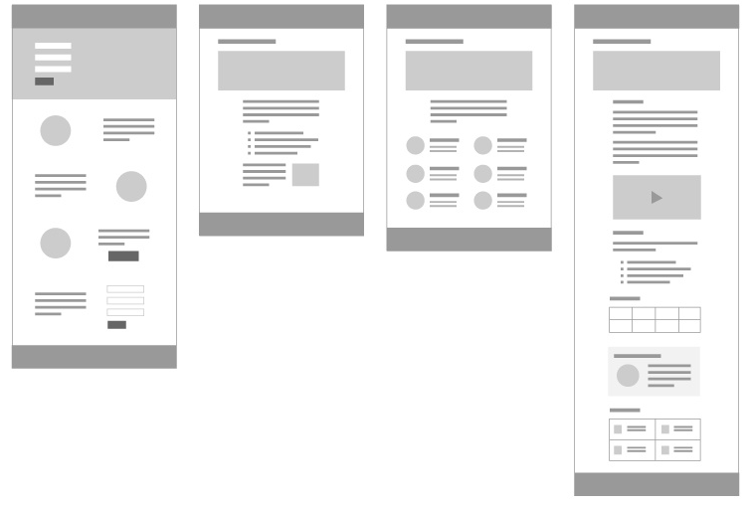
lo-fi monochromatic wireframes
Notes:
At this stage in the prototyping process, we’re moving from paper to screen and incrementally increasing the fidelity.
A wireframe is essentially a ‘skeleton’ for your design.
focused on structure, as opposed to look and feel
wireframes help you to focus on functionality and not get lost in detail.
Wireframes distill the interface down to simple, monochromatic shapes and
are helpful for communicating high-level structure.

Slide 23
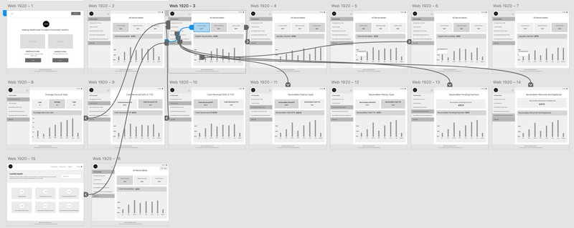
high-fidelity, clickable mock-ups
Notes:
Once you’ve used your lo-fi clickable prototypes to iron out any issues, it’s time to build a higher fidelity prototype to provide a more realistic experience.
This is the final stage of the prototyping process before you start to build prototypes using the medium you’re designing for, for example, HTML, CSS and JavaScript, if you’re building a website or a language like Swift, if you’re building an app for a mobile context.

Slide 24
few rules
create multiple sketches
sketches must be different and unique, otherwise you risk committing to the one idea
detail is not important, you are trying to establish hierarchy
medium is not important
pen and paper
post it notes
word document
PowerPoint presentation

Slide 25
prototyping is about considering solutions
testing is about verifying assumptions

